Slide 1
Assignments and Arithmetic Operators
ELEC1006: ENGINEERING COMPUTING

Slide 2
Operators
Assignment (=)
Arithmetic operators (+, -, *, /, %)
Compound assignment (+=,-=,*=,/=, %=, >>=,<<=, &=, ^=, |=)
Increase and decrease (++, --)
Relational and equality operators (<, >, <=, >=, ==, !=)
Logical operators (!, &&, ||)
Bitwise operators (&, |, ^, ~, <<, >>)
Conditional operator (?)
Comma operator (,)
Bitwise operator
Explicit type casting operator
Precedence of operators
PAGE 2

Slide 3
Assignment (=)
Assignment operator assigns a value to a variable
a=5;
Most important rule in ‘assignment’ is ‘right-to-left’, i.e., the operation always takes place from the right to left. a=b; (whatever in a will be overwritten by the contents of b)
a=2+(b=5); b=5; a=2+b;
a=b=c=5; c=5; b=c; a=b;
PAGE 3

Slide 4
Multiple Assignments
The = can be used to assign a value to multiple variables:
x = y = z = 5;
Value of = is the value that is assigned
Associates right to left:
x = (y = (z = 5));
PAGE 4

Slide 5
Combined Assignment
Look at the following statement:
sum = sum + 1;
sum + 1 adds 1 to the variable sum and stores the result back into variable sum using the assignment =.
New value
of sum
Old value
of sum
PAGE 5

Slide 6
Assignments & Arithmetic Operators
X = 6;
Statement | What It Does | Value of X after the statement
X = X + 4; | Adds 4 to X | 10
X = X – 3; | Subtracts 3 from X | 3
X = X * 10; | Multiplies by 10 | 60
X = X / 2; | Divides X by 2 | 3
X = X % 4; | Makes X the remainder of X/4 | 2
PAGE 6

Slide 7
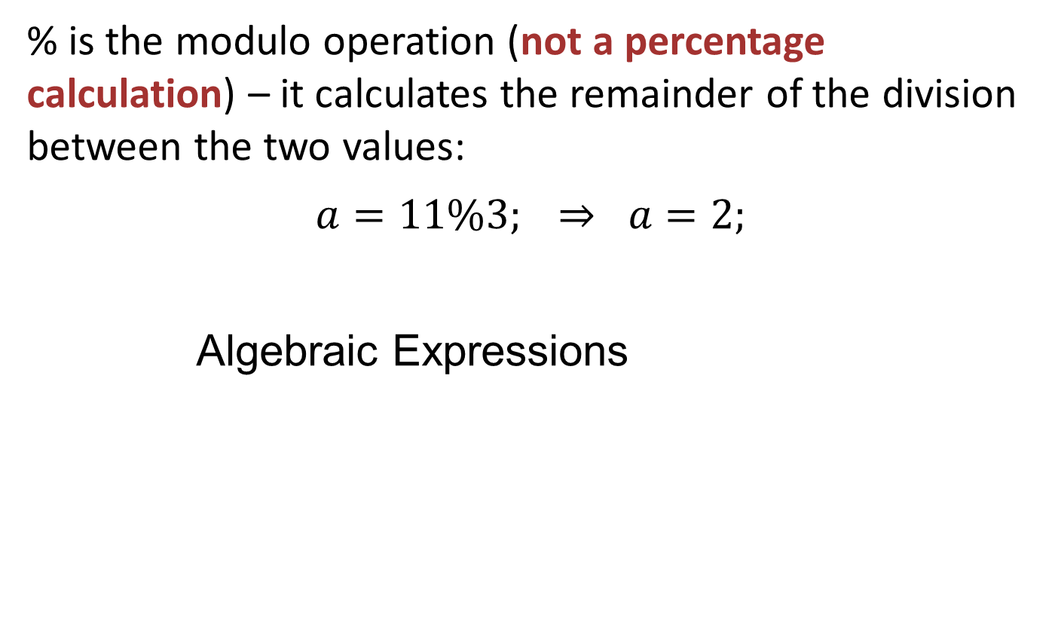
Arithmetic Operators (+, - , *, /, %)
% is the modulo operation (not a percentage calculation) – it calculates the remainder of the division between the two values:
$$a=11\%3; ⇒ a=2;$$
Algebraic Expressions
Algebraic Expression | Operation | C++ Equivalent
2x | 2 times x | 2 * x
(4)(7) | 4 times 7 | 4 * 7
3ab | 3 times a times b | 3 * a * b
PAGE 7

Slide 8
Algebraic Expressions
Multiplication requires an operator:
Area=lw is written as Area = l * w;
There is no exponentiation operator:
Area=s² is written as Area = pow(s, 2);
Parentheses may be needed to maintain order of operations:
is written as
m = (y2-y1) /(x2-x1);
NOT
m = y2-y1/x2-x1;
PAGE 8

Slide 9
Compound Assignment
a += 5; a = a + 5;
a -= 5; a = a - 5;
a /= b; a = a / b;
a *= b+1; a = a * (b+1);
Increase and decrease
a ++;
a += 1;
a = a + 1;
PAGE 9

Slide 10
Compound Assignment
Increase and decrease
a ++;
a += 1;
a = a + 1;
++a ;
a = a + 1;
If a=2, b=5
c=a ++*b;
c=a*b;
a=a++;
c=10;
a=3;
c=++a *b;
a=a++;
c=a*b;
a=3;
c=15;
Same rules apply to --
PAGE 10

Slide 11
More info on C++
[1] cplusplus.com: Operators
https://cplusplus.com/doc/tutorial/operators/
PAGE 11

Slide 12
Other Common Operators
ELEC1006: ENGINEERING COMPUTING

Slide 13
Operators
Assignment (=)
Arithmetic operators (+, -, *, /, %)
Compound assignment (+=,-=,*=,/=, %=, >>=,<<=, &=, ^=, |=)
Increase and decrease (++, --)
Relational and equality operators (<, >, <=, >=, ==, !=)
Logical operators (!, &&, ||)
Bitwise operators (&, |, ^, ~, <<, >>)
Conditional operator (?)
Comma operator (,)
Bitwise operator
Explicit type casting operator
Precedence of operators.
PAGE 13

Slide 14
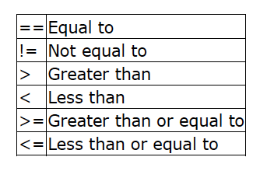
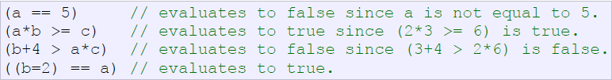
Relational and Equality Operators
Used to evaluate a comparison between two expressions
== is not the same as =
e.g. a=2, b=3, c=6;
What will this statement produce b=2==a ?????
PAGE 14

Slide 15
Logical Operators
! Is the logic NOT operation (only has ONE operand)
&& is the logic AND operation (needs TWO operand)
|| is the logic OR operation (Two operand)
e.g. a=3, b=5;
!(a==b) is true (similar to a!=b)
(a>3)&&(b<7) is false
(a>3)||(b<7) is true
PAGE 15

Slide 16
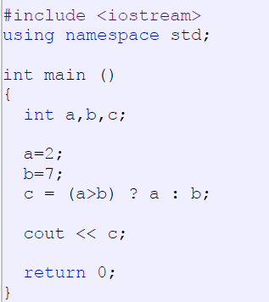
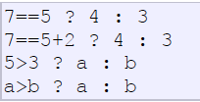
Conditional Operator
Evaluates an expression returning a value if that expression is true and a different one if the expression is false.
Its format is:
condition ? result1 : result2
True – result 1
False – result 2
PAGE 16

Slide 17
Comma Operator
Used to separate two or more expressions that are included where only one expression is expected
When the set of expressions has to be evaluated for a value, only the rightmost expression is considered:
a = (b = 2, b+3); b=2; a=b+3;
PAGE 17

Slide 18
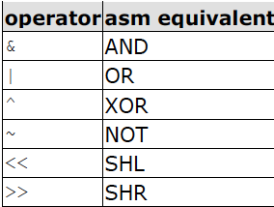
Bitwise Operator (***)
Single bit operations.
1 bit only has binary (2) states.
0 (FALSE) or 1 (TRUE).
NOT inverts states, i.e. 1 → 0 and 0 → 1.
Refer to the Truth Table for the possible states.
SHL refers to shift left operation:
001 → 010.
SHR refers to shift right operation:
110 → 011.
Truth Table
Input 1 | Input 2 | AND | OR | XOR
0 | 0 | 0 | 0 | 0
0 | 1 | 0 | 1 | 1
1 | 0 | 0 | 1 | 1
1 | 1 | 1 | 1 | 0
PAGE 18

Slide 19
Type Casting Operator
Operations are performed between operands of the same type.
If not of the same type, C++ will convert one to be the type of the other
This can impact the results of calculations.
e.g.: float a=10.0;
int b=4;
int c=a/b;
c = 2 instead of c = 2.5 due to c
being an integer instead of float.
PAGE 19

Slide 20
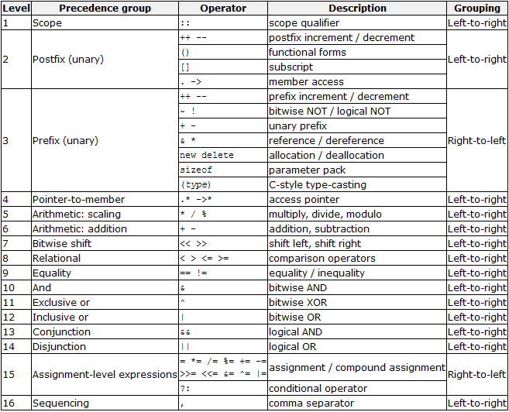
Precedence of Operators
PAGE 20

Slide 21
Precedence | Operator | Description | Associativity
1 | :: | Scope resolution | Left-to-right →
2 | a++ a-- | Suffix/postfix increment and decrement
 | type() type{} | Functional cast
 | a() | Function call
 | a[] | Subscript
 | . -> | Member access
3 | ++a --a | Prefix increment and decrement | Right-to-left ←
 | +a -a | Unary plus and minus
 | ! ~ | Logical NOT and bitwise NOT
 | (type) | C-style cast
5 | a*b a/b a%b | Multiplication, division, and remainder
6 | a+b a-b | Addition and subtraction
 |  |  | Left-to-right →
7 | << >> | Bitwise left shift and right shift
8 | <=> | Three-way comparison operator (since C++20)
 |  |  | Left-to-right →
9 | < <= > >= | For relational operators < and ≤ and > and ≥ respectively
 |  |  | Left-to-right →
10 | == != | For equality operators = and ≠ respectively
11-13 | &, ^, | | Bitwise AND, XOR and OR
 |  |  | Left-to-right →
14 | && | Logical AND
15 | || | Logical OR
16 | a?b:c | Ternary conditional^{[note 2]} | Right-to-left ←
 | = | Direct assignment (provided by default for C++ classes)
 | += -= | Compound assignment by sum and difference
 | *= /= %= | Compound assignment by product, quotient, and remainder
 | <<= >>= | Compound assignment by bitwise left shift and right shift
 | &= ^= |= | Compound assignment by bitwise AND, XOR, and OR
17 | , | Comma | Left-to-right →

Slide 22
More info on C++
[1] cplusplus.com: Operators
https://cplusplus.com/doc/tutorial/operators/
PAGE 22

Slide 23
if Conditional Branch
ELEC1006: ENGINEERING COMPUTING

Slide 24
Conditional Branches
Defined as a condition that causes the program to change the path of execution based on the value of an expression.
Forms of conditional branches:
if statement. ←
switch statement.
PAGE 24

Slide 25
if Statement
The ‘if’ (a keyword) is to execute a statement or a block of statements only if a condition is satisfied. The form is:
if (condition) statement
e.g. if (x>90)
cout << “A very good score!” << endl;
This ‘cout statement’ will only be executed if the value in x is greater than 90.
PAGE 25

Slide 26
Multiple Lines of Code
if multiple lines of code is to be executed under an if statement, {} should be used.
Do NOT put ; after the if (condition) statement.
e.g. if (x>90)
{
cout << “Congratulation!”<< endl;
cout << “A very good score of ”;
cout << x << “.” << endl;
}
PAGE 26

Slide 27
Two Conditional Branches
The else statement can be used to specify what to do if the ‘if’ condition is not met.
e.g. if (x>90) // Condition 1
cout << “Congratulation!”<<endl;
else // Condition 2
cout << “You can improve your score”;
PAGE 27

Slide 28
Multiple Conditional Branches
Use if – else if – else for a range of conditional branches.
e.g.
if (x<0) // Condition 1
cout << “x is negative.”<<endl;
else if (x>0) // Condition 2
cout << “x is positive.”<<endl;
else // Condition 3
cout << “x is 0.” <<endl;
PAGE 28

Slide 29
Commas in if Statement
Use of commas ,
e.g.
int a=1,b=2,c=10,d=20;
if (a<0) c*=10, d*=20;
else if (a<b) c/=10, d/=20;
else c=b;
PAGE 29

Slide 30
Previous code is equivalent to:
int a=1;
int b=2;
int c=10;
int d=20;
if (a<0)
{
c=c*10;
d=d*20;
}
else if (a<b)
{
c=c/10; d=d/20;
}
else
c=b;
Too long? – But, use this!
PAGE 30

Slide 31
More info
[1] cplusplus.com: Statements and flow control
https://cplusplus.com/doc/tutorial/control/
[2] learncpp.com: 5.2 – If statements
https://www.learncpp.com/cpp-tutorial/52-if- statements/
PAGE 31

Slide 32
switch Conditional Branch
ELEC1006: ENGINEERING COMPUTING

Slide 33
Conditional Branches
Defined as a condition that causes the program to change the path of execution based on the value of an expression.
Forms of conditional branches:
if statement.
switch statement. ←
PAGE 33

Slide 34
switch Statement
switch statement is a natural choice for menu-driven program:
display the menu
then, get the user's menu selection
use user input as expression in switch statement
use menu choices as expr in case statements
if-else can be used in place of switch.
PAGE 34

Slide 35
switch Statement Format
switch (expression) //integer
{
case exp1: statement1;
case exp2: statement2;
...
case expn: statementn;
default: statementn+1;
}
PAGE 35

Slide 36
break Statement
Used to exit a switch statement
If it is left out, the program "falls through" the remaining statements in the switch statement
Example:
switch (n) {
case ’a':
cout << ”a has been given.\n";
break;
case ’b':
cout << ”b has been given.\n";
break;
default:
cout << "unknown character!\n";
break;
}
PAGE 36

Slide 37
Alternative Program
Use if - else if - else statement as an alternative to switch:
Example:
if (n == ‘a’)
cout << ”a has been given.\n";
else if (n == ’b’)
cout << ”b has been given.\n";
else
cout << "unknown character!\n";
}
PAGE 37

Slide 38
More info
[1] cplusplus.com: Statements and flow control
https://cplusplus.com/doc/tutorial/control/
[2] learncpp.com: 5.3 – Switch statements
https://www.learncpp.com/cpp-tutorial/53-switch- statements/
[3] cppreference.com: switch statement https://en.cppreference.com/w/cpp/language/switch
PAGE 38

Slide 39
while Iteration Statement
ELEC1006: ENGINEERING COMPUTING

Slide 40
Iteration Statement (loops)
Loops are used to repeat a statement a certain number of times when a condition is met.
There are three types of loops:
while loop. ←
do-while loop.
for loop.
PAGE 40

Slide 41
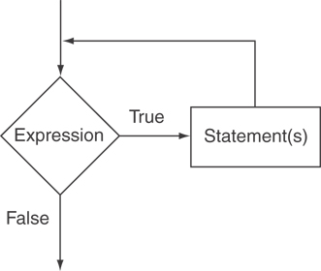
The while Loop
The format is:
while (expression or condition) { Statement(s) }
– repeat while “expression or condition” is true.
The logical flow of while loop:
PAGE 41

Slide 42
Example
// custom countdown using while
#include <iostream>
using namespace std;
int main ()
{
int n;
cout << "Enter the starting number: ";
cin >> n;
while (n>0) // Don’t put ; at the end
{
cout << n << ", ";
--n; // Decrement n by 1 in every loop
}
cout << "FIRE!\n";
return 0;
}
PAGE 42

Slide 43
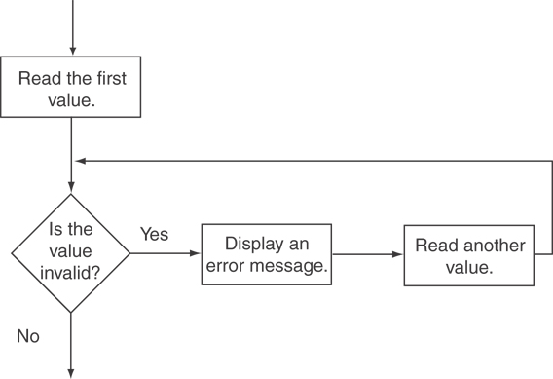
Input validation
cout << "Enter a number less than 10: ";
cin >> number;
while (number >= 10)
{
cout << "Invalid Entry!" << "Enter a number less than 10: ";
cin >> number;
}
PAGE 43

Slide 44
Tips: When to use while
Use while statement when the number of times the loop is required to run is unknown.
Use while (1) to form an infinite loop especially when using a simple program that runs for long periods of time, e.g. mobile phone call:
while (1)
{
read_input(); // 1) Get network data
process_data(); // 2) Convert into sound signal
output_data(); // 3) Play signal on speaker
if call_end()
break; // Break the while loop if call ends
}
PAGE 44

Slide 45
More info
[1] cplusplus.com: Statements and flow control
https://cplusplus.com/doc/tutorial/control/
[2] learncpp.com: 5.5 – While statements
https://www.learncpp.com/cpp-tutorial/55-while- statements/
PAGE 45

Slide 46
do-while Iteration Statement
ELEC1006: ENGINEERING COMPUTING

Slide 47
Iteration Statement (loops)
Loops are used to repeat a statement a certain number of times when a condition is met.
There are three types of loops:
while loop.
do-while loop. ←
for loop.
PAGE 47

Slide 48
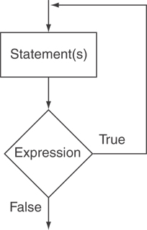
The do-while Loop
The format is:
do { statements } while (expression or condition);
Only difference with the while statement is that do-while evaluates the condition after executing the statements.
do-while Loop Logic
while Loop Logic
PAGE 48

Slide 49
Example
// Number echo
#include <iostream>
using namespace std;
int main ()
{
unsigned long n;
do {
cout << "Enter number (0 to end): ";
cin >> n;
cout << "You entered: " << n << "\n";
} while (n != 0); // Must use ;
return 0;
}
PAGE 49

Slide 50
Notes on do-while
Loop always executes at least once.
Execution continues as long as the expression is true and stops the repetition when the expression becomes false.
Useful in menu-driven programs to bring user back to menu to make another choice.
PAGE 50

Slide 51
Menu –driven Program
#include <iostream>
using namespace std;
int main()
{
int selection; // Selection variable
do {
cout << "Please make a selection: \n"; // List menu
cout << "1) Addition\n";
cout << "2) Subtraction\n";
cout << "3) Multiplication\n";
cout << "4) Division\n";
cin >> selection; // Get user menu selection
} while (selection != 1 && selection != 2 && selection != 3 && selection != 4);
// Do something with the selection here
return 0;
}
PAGE 51

Slide 52
More info
[1] cplusplus.com: Statements and flow control
https://cplusplus.com/doc/tutorial/control/
[2] learncpp.com: 5.6 – Do while statements
https://www.learncpp.com/cpp-tutorial/56-do-while- statements/
PAGE 52

Slide 53
for Iteration Statement
ELEC1006: ENGINEERING COMPUTING

Slide 54
Iteration Statement (loops)
Loops are used to repeat a statement a certain number of times when a condition is met.
There are three types of loops:
while loop.
do-while loop.
for loop. ←
PAGE 54

Slide 55
The for Loop
for loop is used when we know how many iterations (loops) are required.
Test each expression before each iteration in the for loop and so, it is known as a pre-test loop similar to while loop.
Note: do-while loop is known as a post-test loop, where the statements executed at least once (one iteration) before the expression is checked.
PAGE 55

Slide 56
for Loop Syntax
The format is:
for (initialisation; expression; increase or decrease)
{
statements
}
– Note: No ; after the )
The mechanics:
Perform initialisation
Evaluate test expression
If true, execute statement
If false, terminate loop execution
Execute update, then re-evaluate test expression
Test
Update
PAGE 56

Slide 57
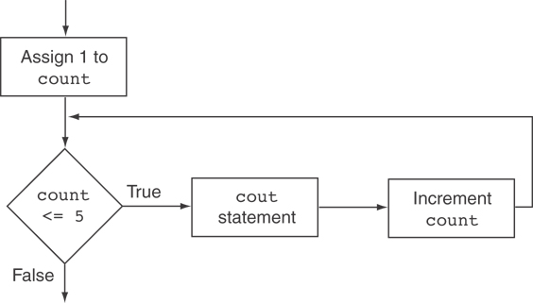
Example
for (int count = 1; count <= 5; count++)
{
cout << "Hello" << endl;
}
Flowchart
PAGE 57

Slide 58
while Loop Equivalent
for (int count = 1; count <= 5; count++)
{
cout << "Hello" << endl;
}
for loop is like an advanced while loop
int count=1;
while (count <= 5)
{
cout << "Hello" << endl;
count++;
}
PAGE 58

Slide 59
Variations using commas
Can also have multiple initialisation and update expressions. Separate the statements with commas ,: int x, y; for (x=1, y=1; x <= 5; x++, y++) { cout << x << " plus " << y << " equals " << (x+y) << endl; }
Initialisations
updates
PAGE 59

Slide 60
Scope of Variables
You can declare variables in the initialisation expression.
Variable i only exist in the for loop { … }, not outside of it.
int sum = 0;
for (int i = 0; i <= 10; i++)
{
sum += i; // sum = sum + i
}
PAGE 60

Slide 61
More info
[1] cplusplus.com: Statements and flow control
https://cplusplus.com/doc/tutorial/control/
[2] learncpp.com: 5.7 – For statements
https://www.learncpp.com/cpp-tutorial/57-for- statements/
PAGE 61

Slide 62
Nested Loops & Exit Statement
ELEC1006: ENGINEERING COMPUTING

Slide 63
Combining Loops
Loops can be combined together (nested loops).
The statement within a loop can contain another loop:
int i, j;
for (i = 0; i < 4; i++)
{
for (j = 0; j < 4; j++)
{
// statements
}
}
PAGE 63

Slide 64
Nested Loops
Inner loop goes through all repetitions for each repetition of outer loop
Inner loop repetitions complete sooner than outer loop
Total number of repetitions for inner loop is the product of number of repetitions of the two loops.
PAGE 64

Slide 65
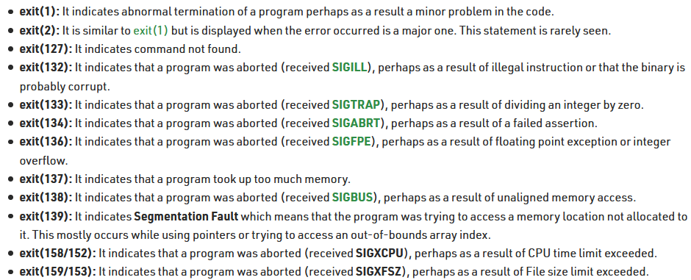
exit() Statement
Use exit(n) to exit the program.
n is a specific exit code:
0 for successful exit.
1 or non-zero number for failure as mentioned below.
PAGE 65

Slide 66
Example
#include <iostream>
using namespace std;
int main ()
{
unsigned long n=1;
for (n; n<5; n++)
{
cout << "hello world\n";
if(n==2)
exit(1);
}
cout << "this is the end of the program.";
return 0;
}
PAGE 66

Slide 67
More info
[1] cplusplus.com: Statements and flow control
https://cplusplus.com/doc/tutorial/control/
[2] cplusplus.com: function exit
https://cplusplus.com/reference/cstdlib/exit/?kw=exit
[3] learncpp.com: 5.7 – For statements
https://www.learncpp.com/cpp-tutorial/57-for- statements/
[4] Exit codes in C/C++ with Examples
https://www.geeksforgeeks.org/exit-codes-in-c-c-with- examples/
PAGE 67

